Slide 1

Strain Damage Monitoring in CFRP Composites using Digital Image Correlation
NCUR 2018
Edmond, OK - April 4 - 7, 2018
Rachael Bradshaw and Dr. Wahyu Lestari,
Embry-Riddle Aeronautical University, Prescott, AZ, USA

Slide 2



Acknowledgments
Embry-Riddle Faculty Innovative Research in Science and Technology (FIRST) Grant
NASA Space Grant Arizona Undergraduate Research Internship
Embry-Riddle Undergraduate Research Institute

Slide 3
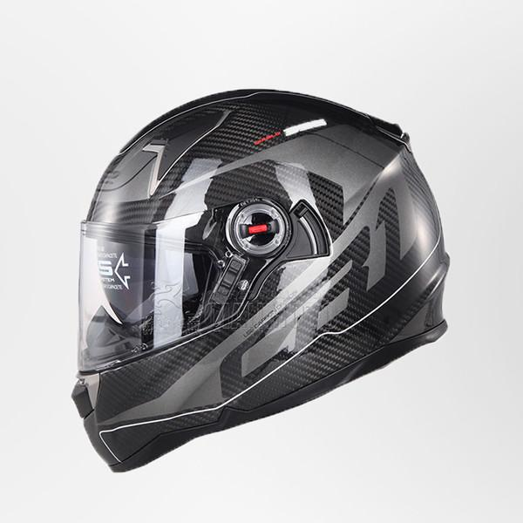
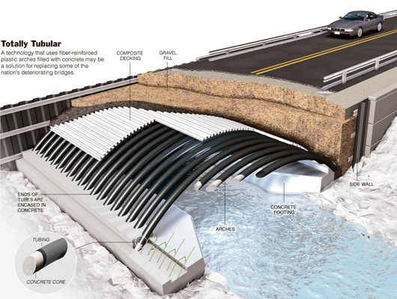
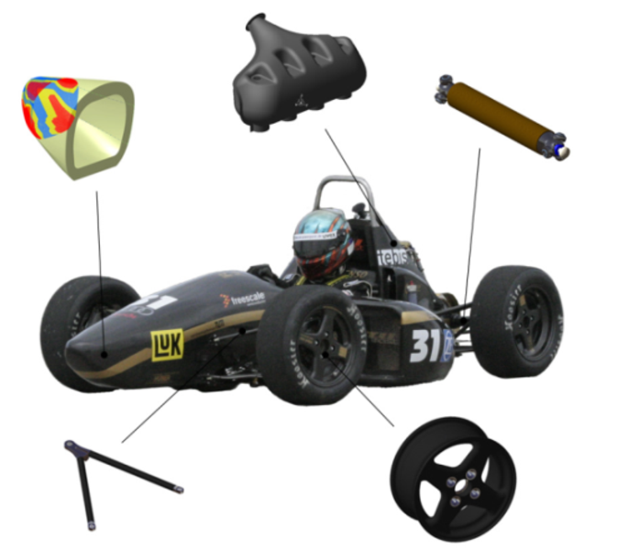
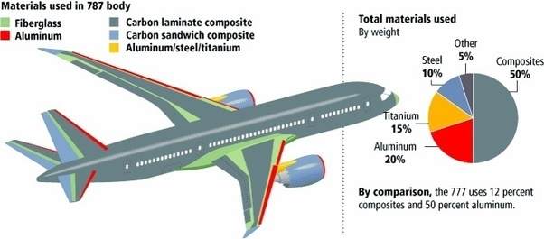
Motivation
Everyday Use
Civil
Carbon Fiber Helmet. Digital Image. Pitaka. 9 Mar 2017
Carbon fiber arches for bridges. Digital Image. Carbon Fiber Gear. 2013
Automotive
Aerospace
Composites in the Aerospace Industry. Digital Image. Quora. 31 Jul 2016
Complex Composite-Parts with CATIA. Digital Image. Technical University of Munich.
Notes:
Fiber reinforced polymer composites are revolutionizing the design of large, high-performance structures in the aerospace, marine and power generation industries -- due to their advantages in areas such as corrosion resistance, specific strength and ability to be customized.
Carbon fiber has a high strength to weight ratio: less material is needed to tolerate large loads in comparison to other materials like steel or aluminum
Rigid: won’t deform and change shape in use
Light weight: helps meet weight requirements
Customizable: when manufacturing, can be molded into any shape, simple -> complex
Applications vary, examples of each field

Slide 4
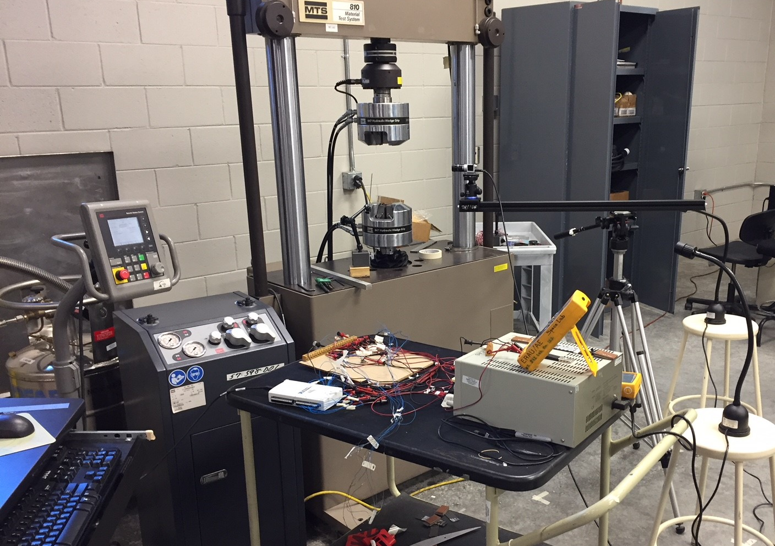
Objective
To identify and monitor strain damage using a digital image correlation (DIC) technique.
Perform experimental tests to identify tensile damage in CFRP composites
  Test pre-damaged samples and pristine samples
Test setup
Notes:
Downfall of carbon composites is they are extremely brittle and when/where they will fail is random with no visual cues. In production, this requires high safety tolerances = more weight = more money.
Our objective is to use DIC to identify where the composite experiences the highest amount of strain and will most likely fail first.
We do tensile testing to break the sample, while simultaneously gathering photos to be analyzed via DIC

Slide 5
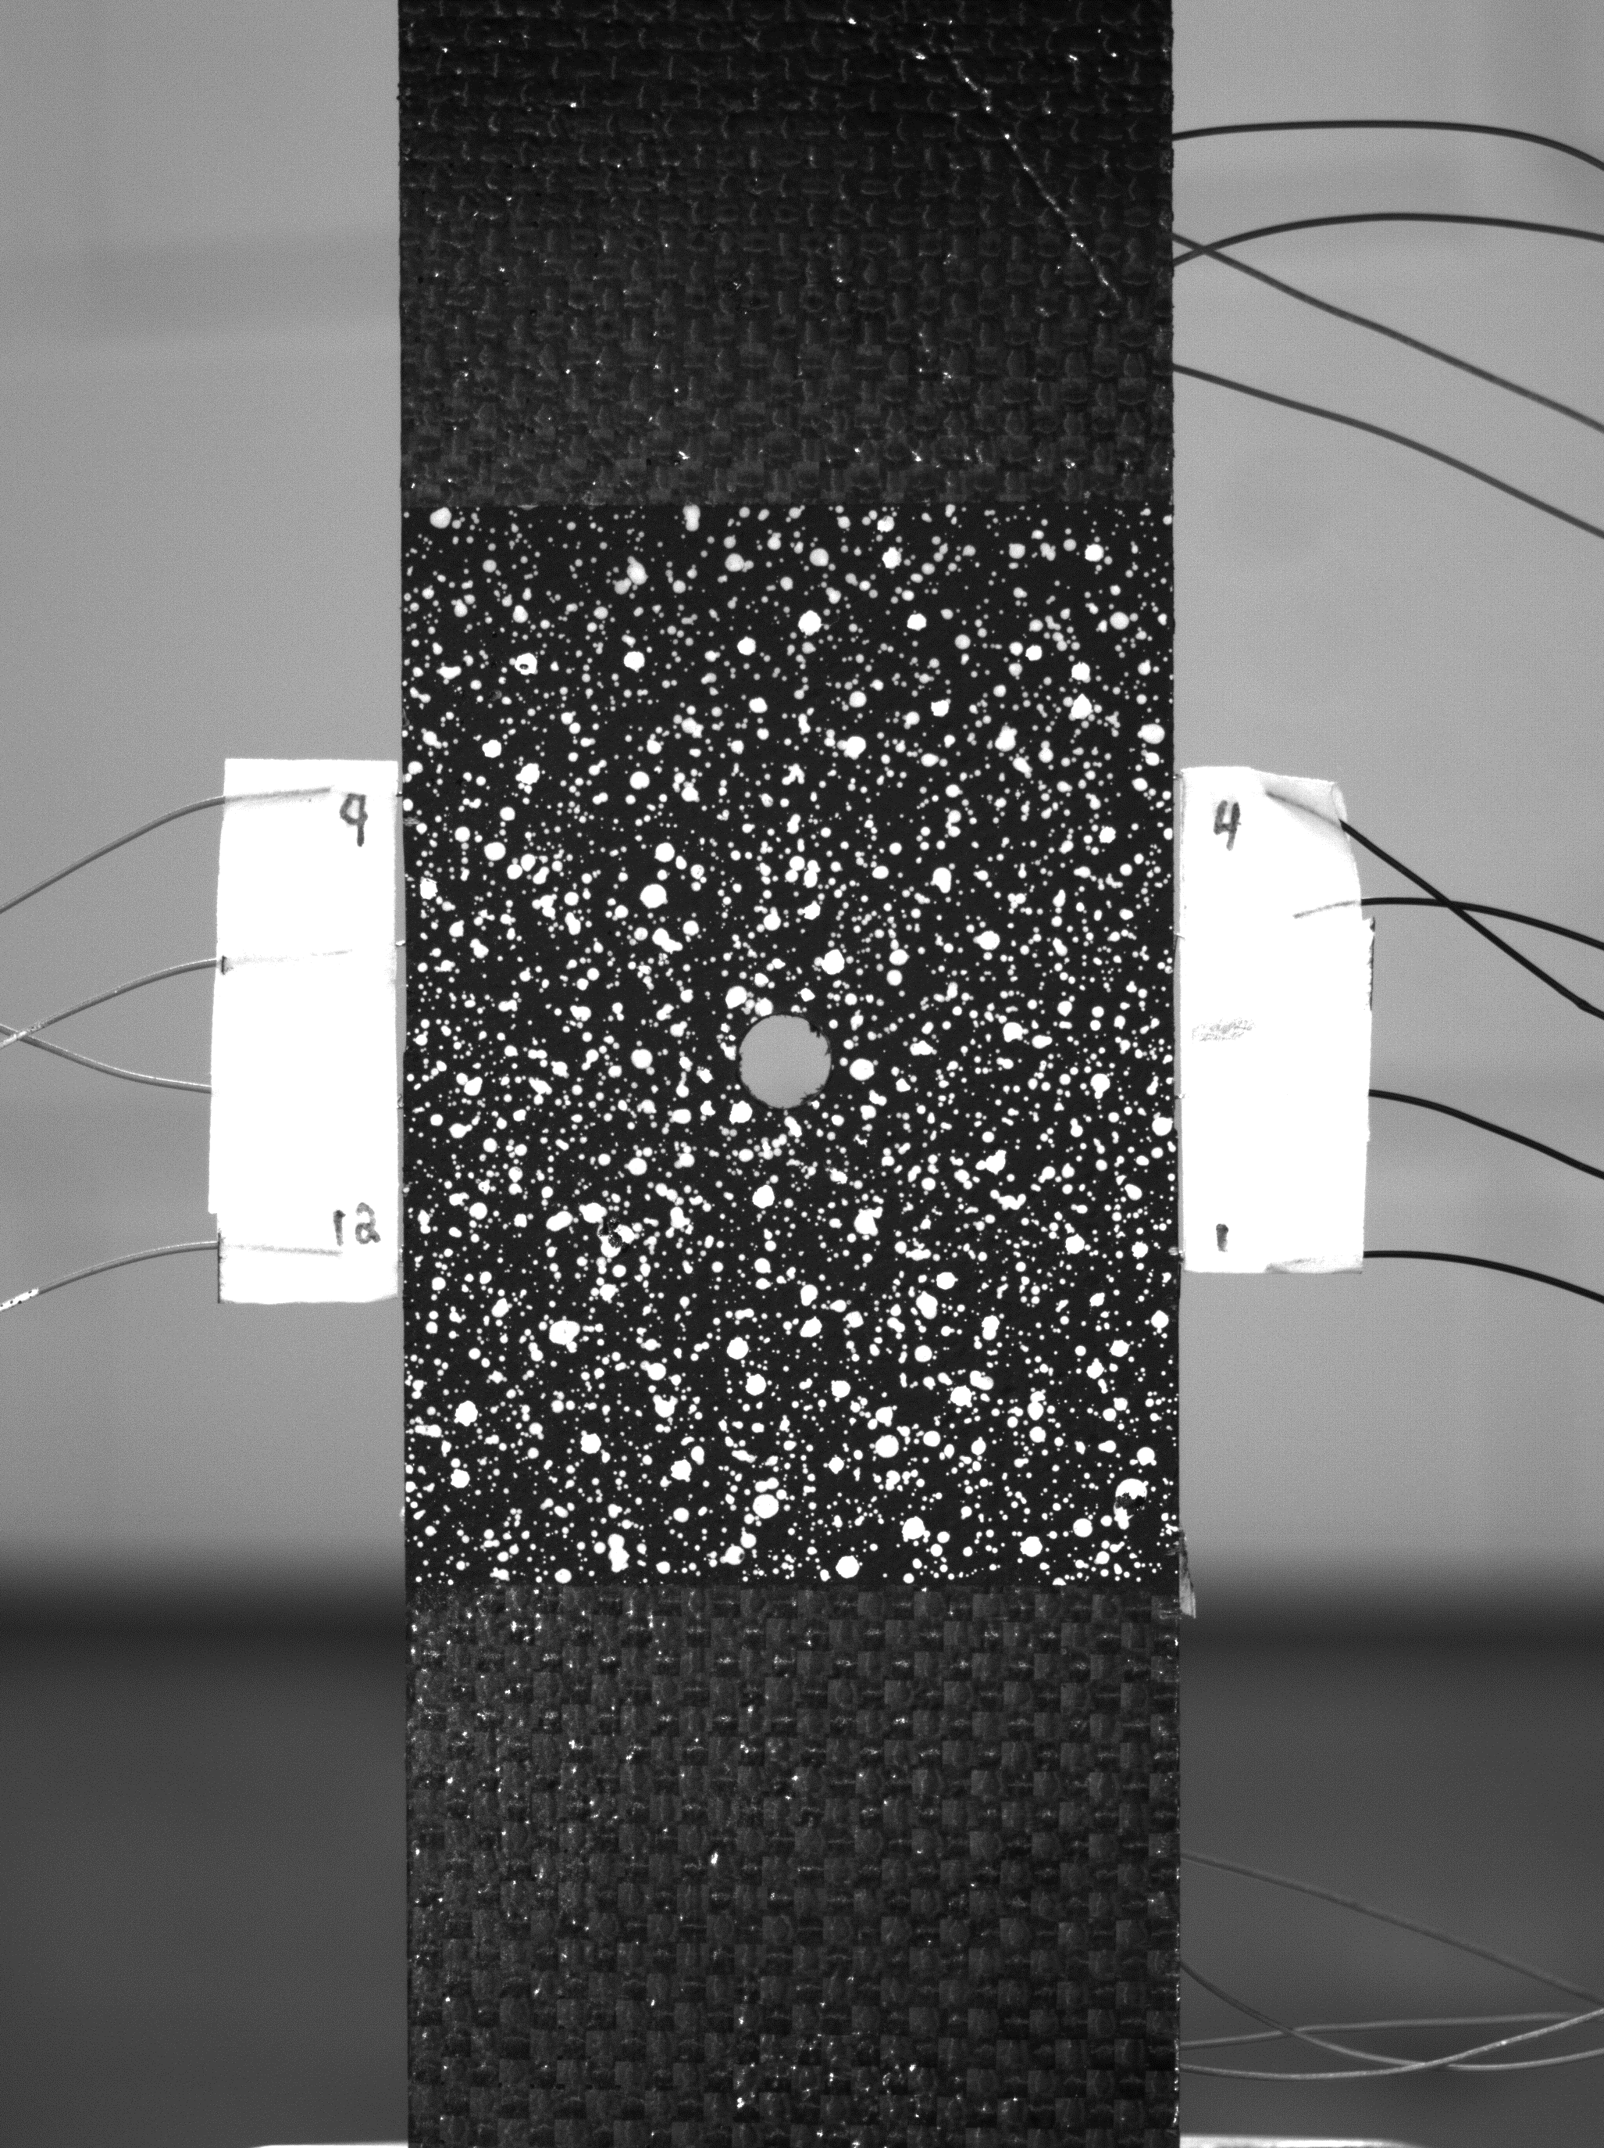
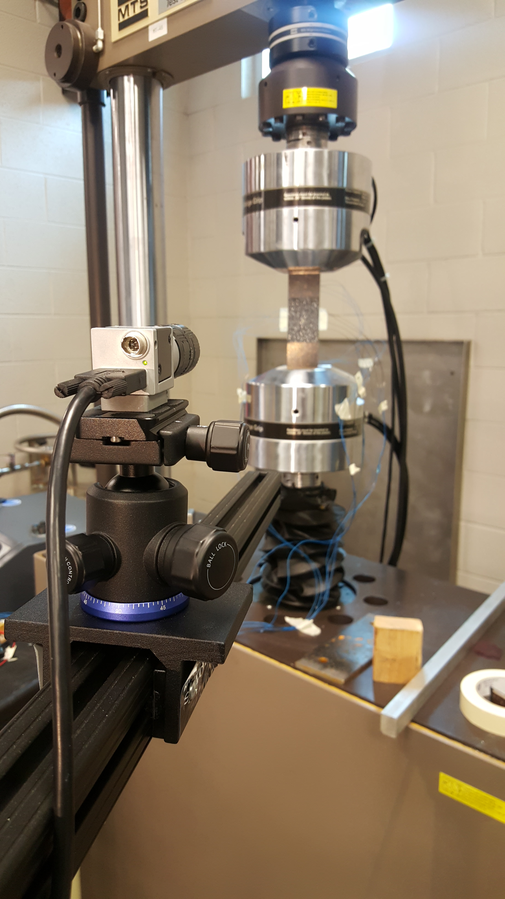
Digital Image Correlation (DIC)
Ncorr open source 2D digital image correlation MATLAB based code
  Digital images ➔ 2D strain fields
Camera setup
Sample photograph
Notes:
Utilize Ncorr, an open based MATLAB software to perform all the DIC algorithms. Process the images and generate the strain fields.
Camera Basler Ace acA3800-14um 10 MP and Basler Lens C125-2522-5MP F2.2 f25mm

Slide 6
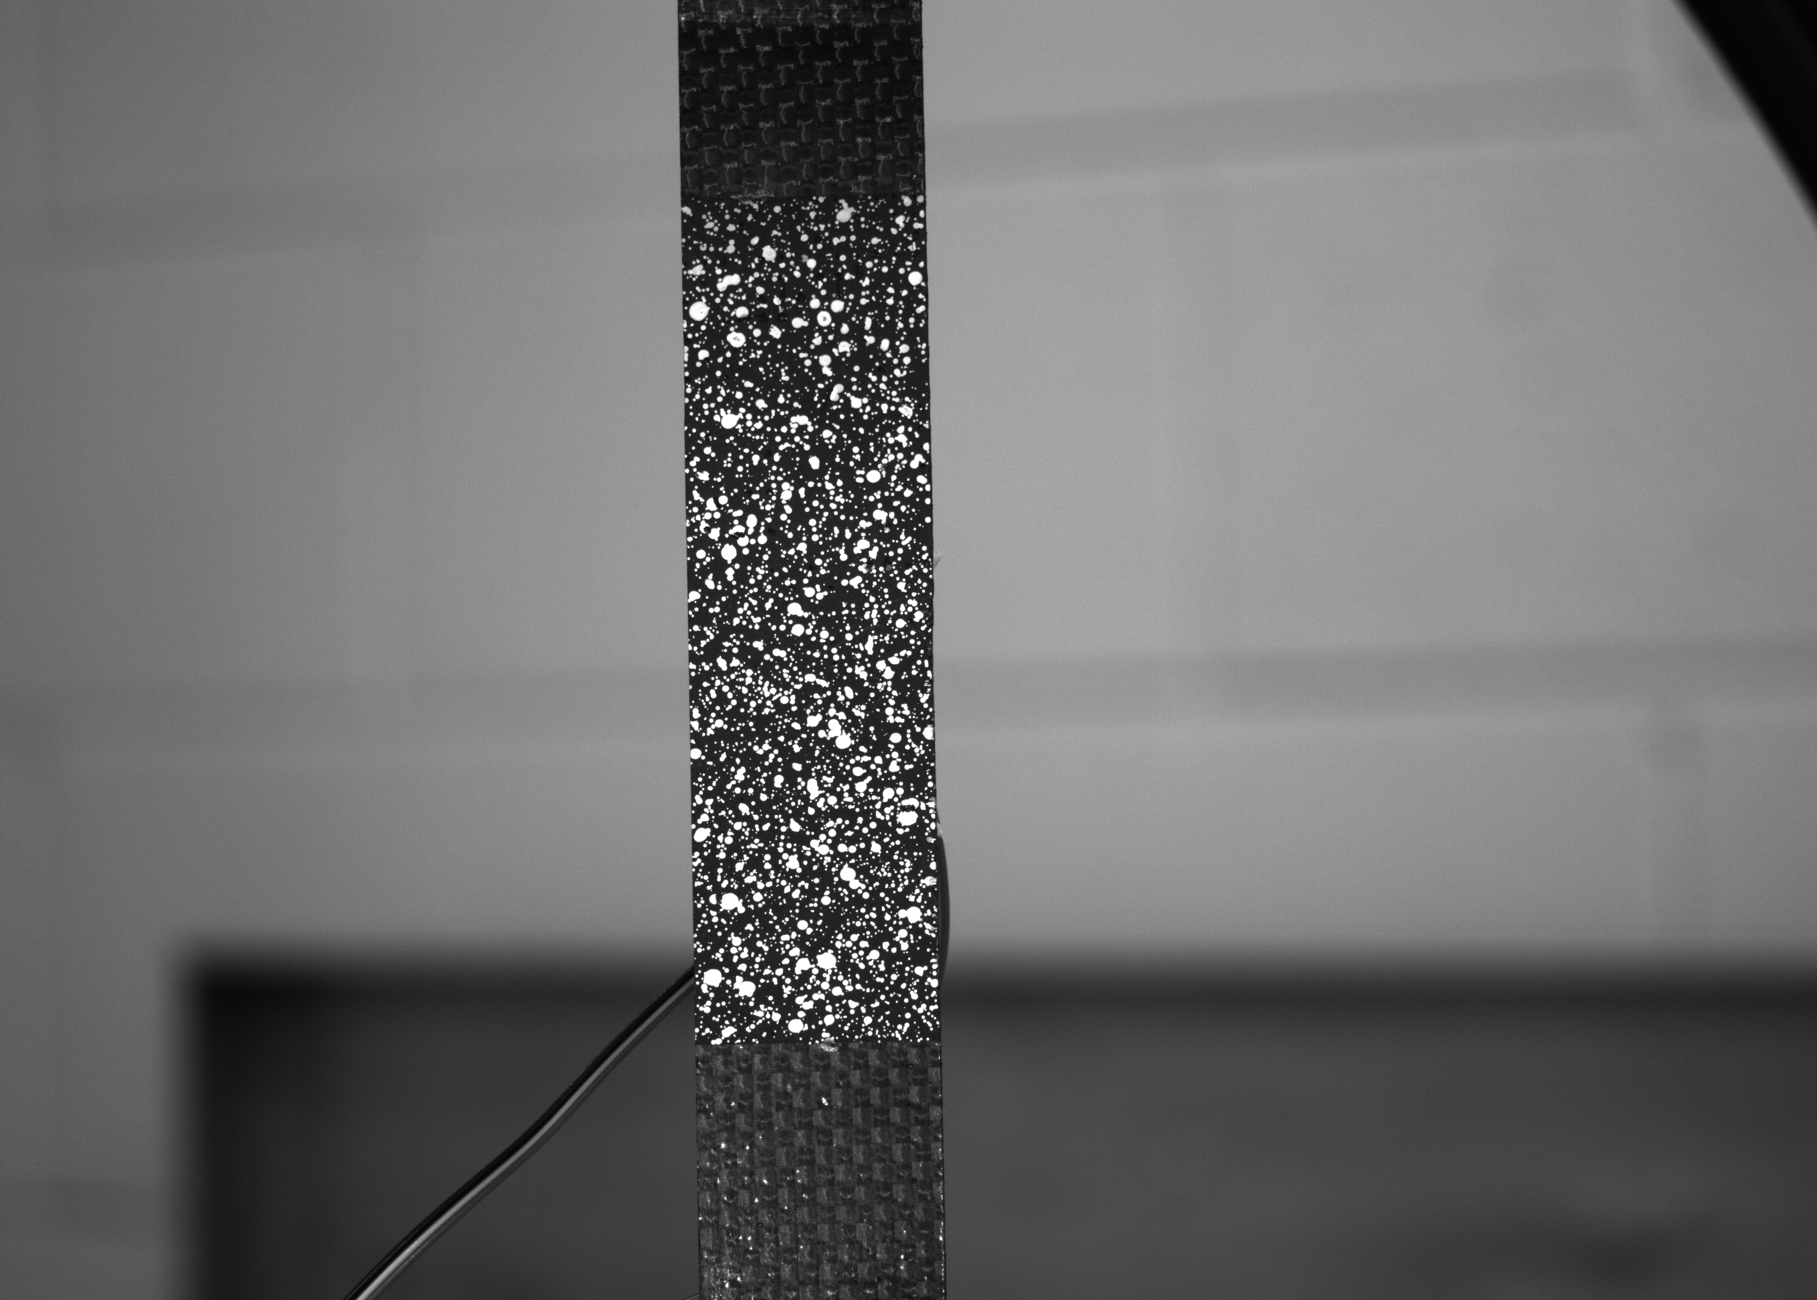
Sample Preparation
Specimen Dimensions: 10 in x 1 in (L x W)
  Fiber: Carbon plain weave 3k, [0/90]₈
  Matrix: Epoxy/hardener (Proset LAM125/LAM237), 3.3:1g
  Curing Cycle: 5 h @ 80°F and 8 h @ 180°F
Speckle pattern
  Paint the area of interest with a black background in several layers
  Spray white paint over the area to create a speckle pattern
Notes:
Vacuum bagged before cured
Plate is tabbed and cut into beams
Speckle: I start with applying a black primer base coat until the carbon pattern is no longer visible. Next, by holding the spray can ~1.5ft away from the sample, I use a white primer to apply a fine speckled pattern
Ncorr literally tracks the movement of each speckle, good quality speckles affect results:
not too big, high contrast, even/random distribution

Slide 7
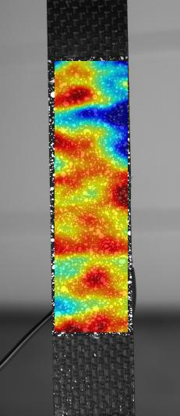
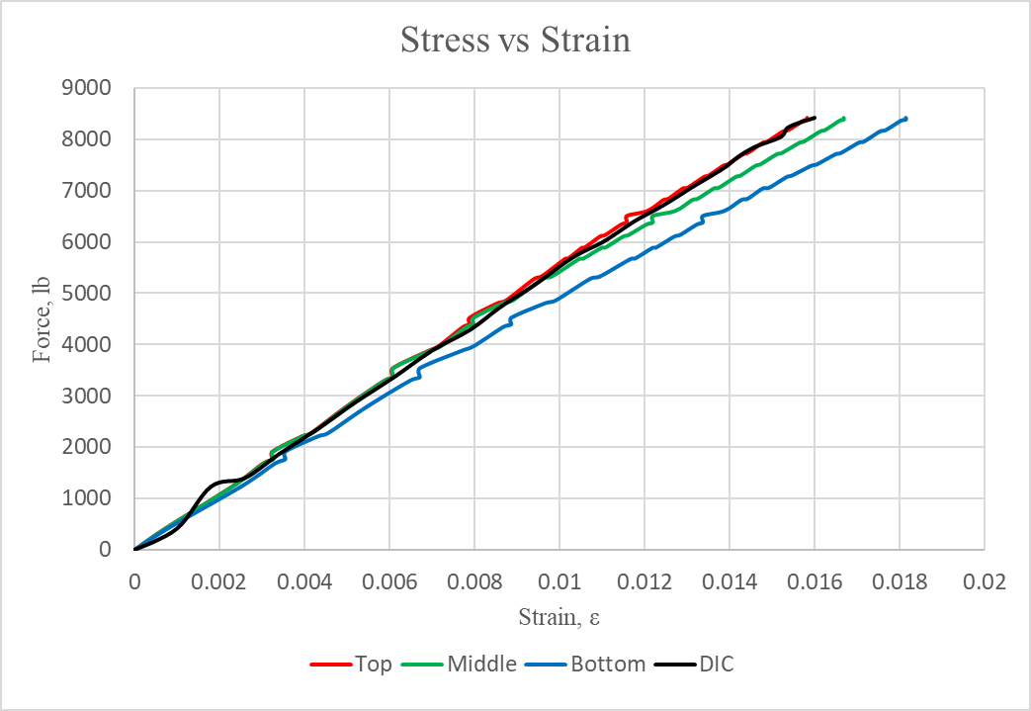
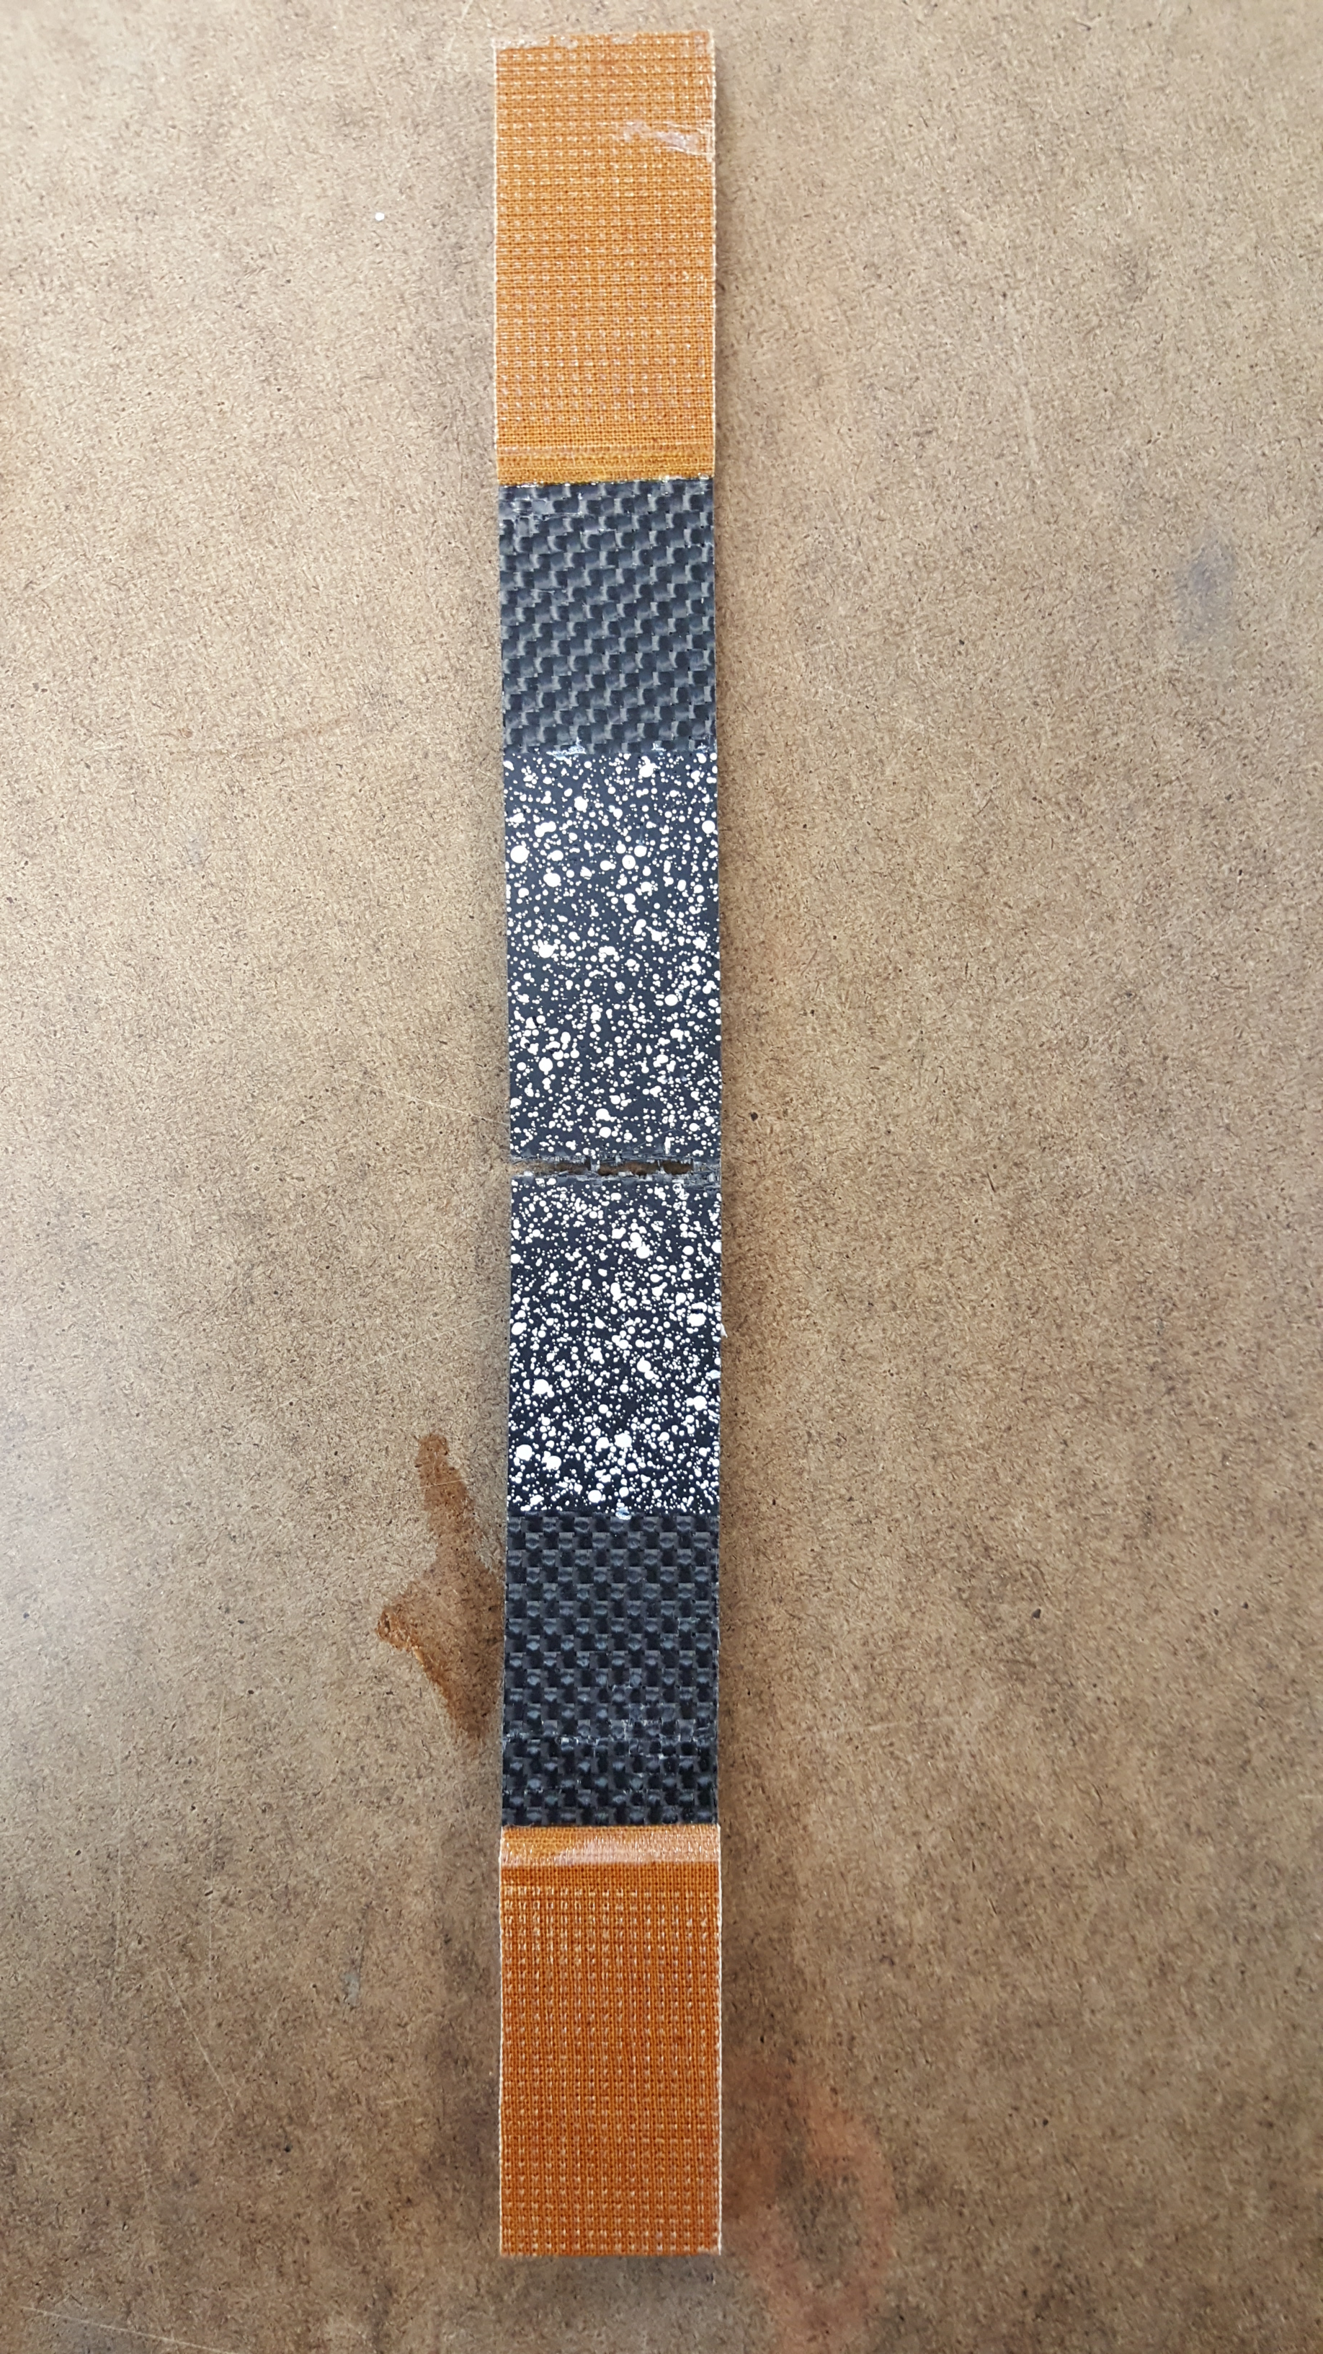
DIC & Strain Gage Results
Maximum strain values:
  Top Gage = 0.015808
  Middle Gage= 0.016686
  Bottom Gage = 0.018146
DIC = 0.0160
Notes:
This beam broke exactly at the middle strain gage. The values are very close
Trend pattern of the DIC matches that of strain gages, proving that the DIC is a reliable method

Slide 8
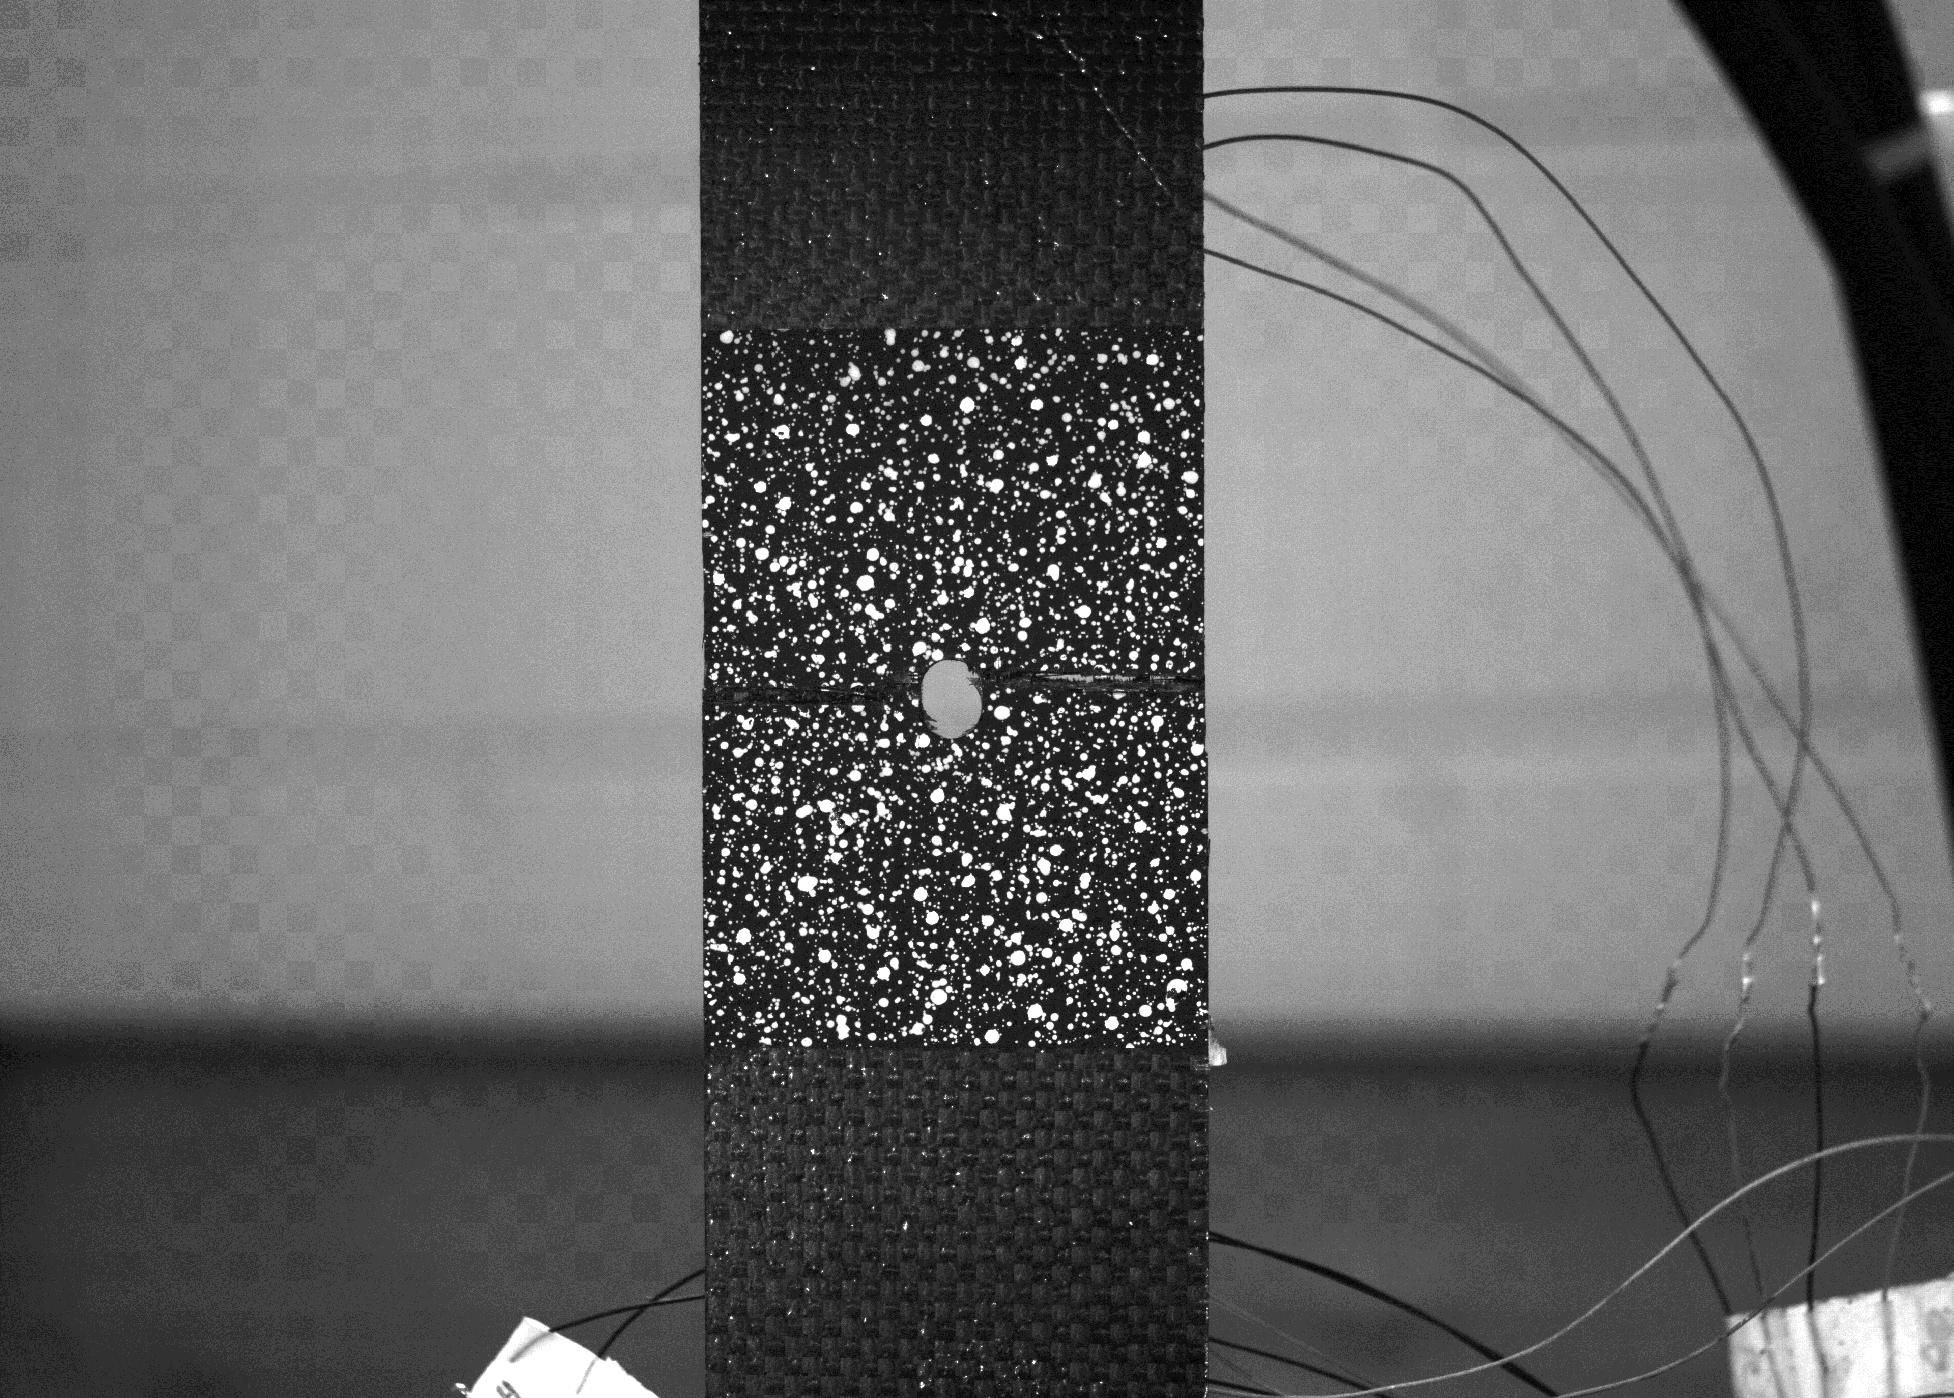
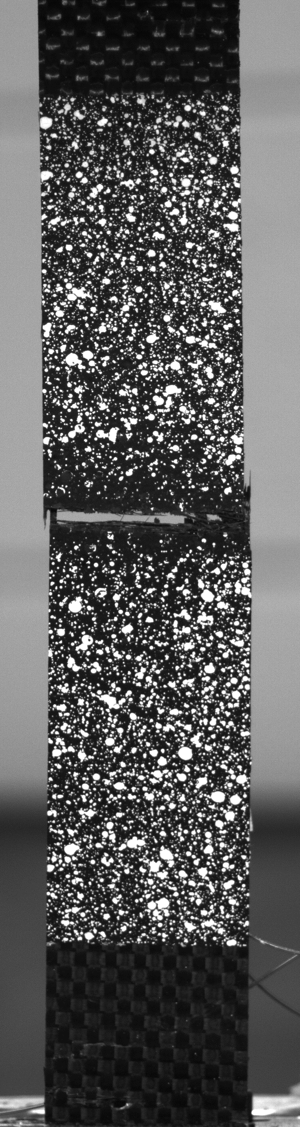
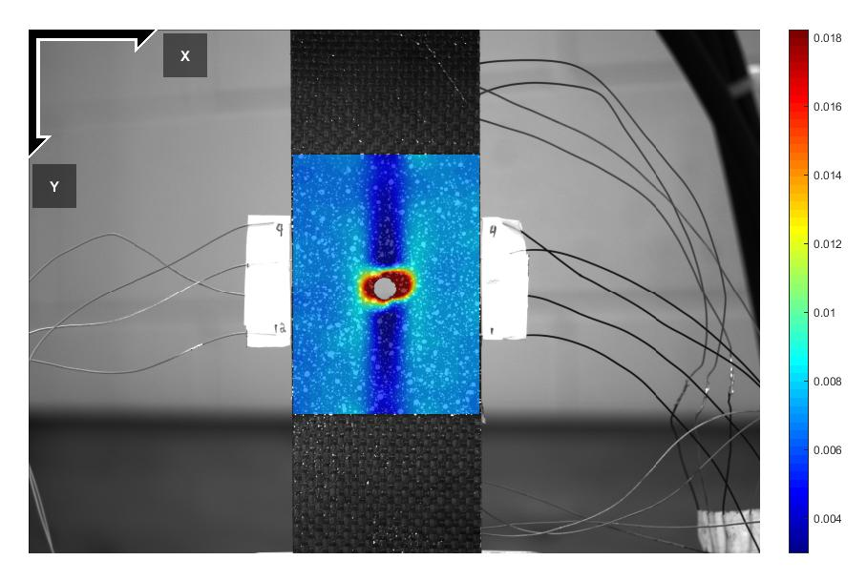
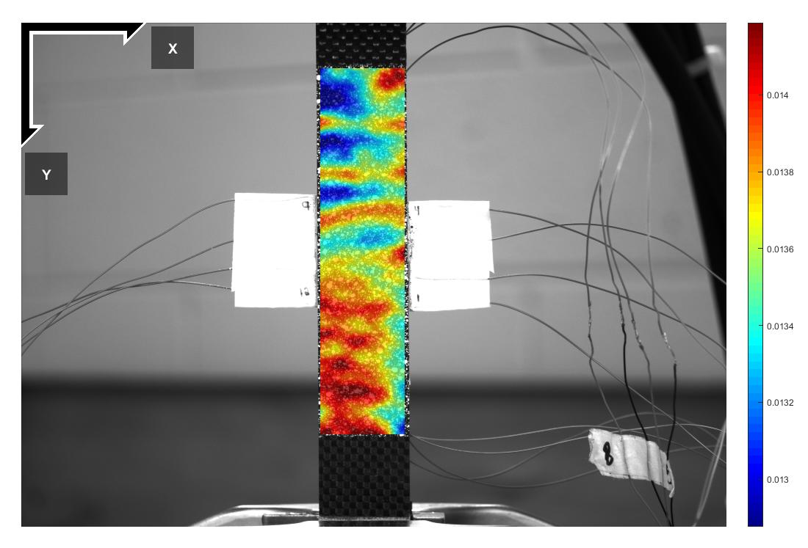
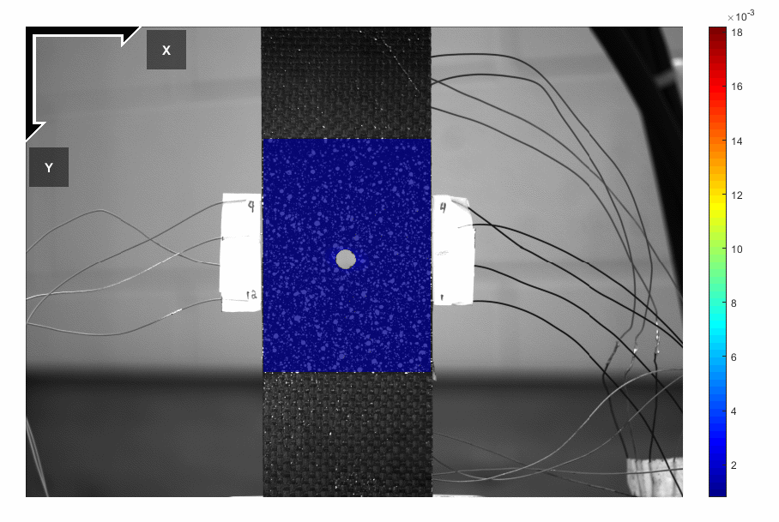
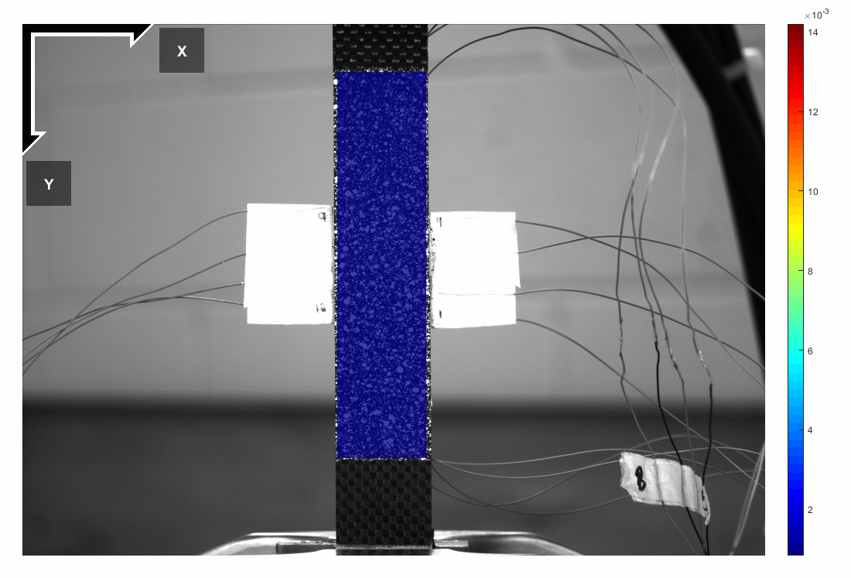
DIC Results (1/2)
Different types of monitoring
Notes:
With hole (pre-damaged):
Clear deformation occurred, indicating it is the region of highest strain
Break was uneven, right side of hole broke higher than the left: is also indicated by the DIC
Without hole:
Results typically show more areas of high strain, can see that it does indicate strain where the beam broke; however, shows that wasn’t the area of MAXIMUM strain
The composite was failing in multiple locations, but there’s no guarantee which will fail first
Can identify both large/small strain and when/where failure is likely to occur.

Slide 9
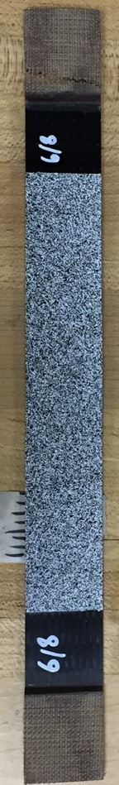
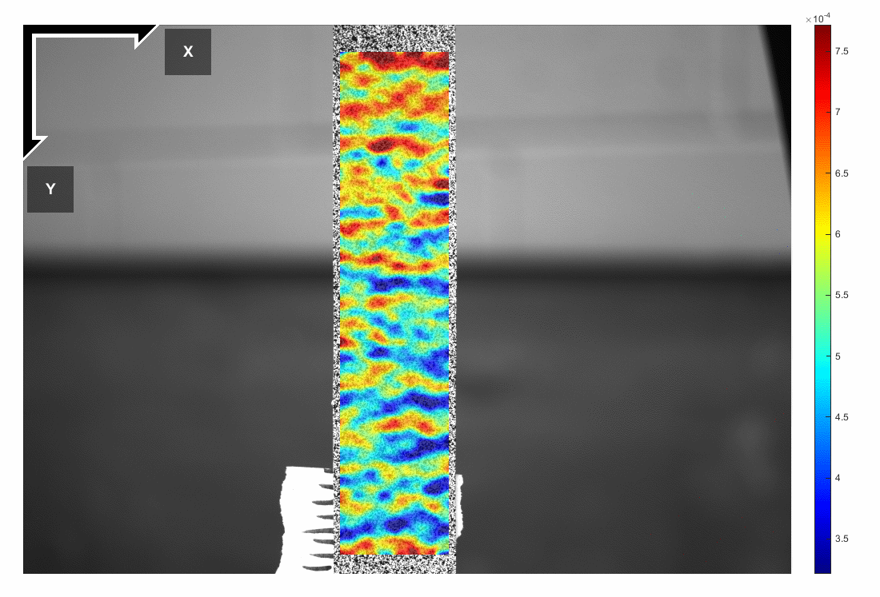
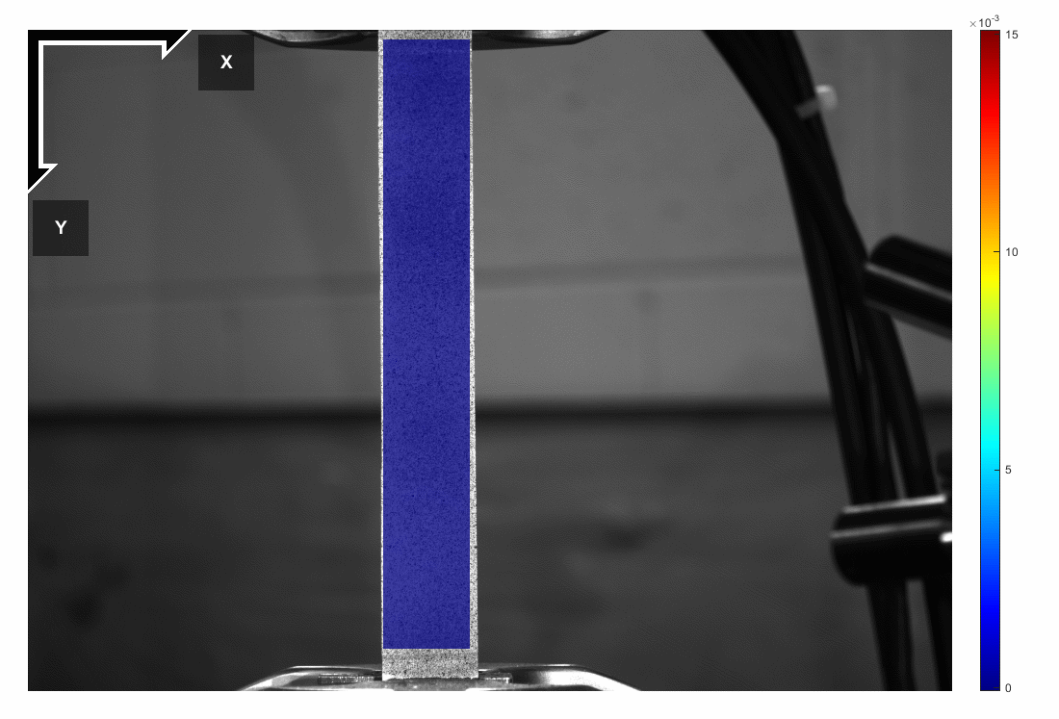
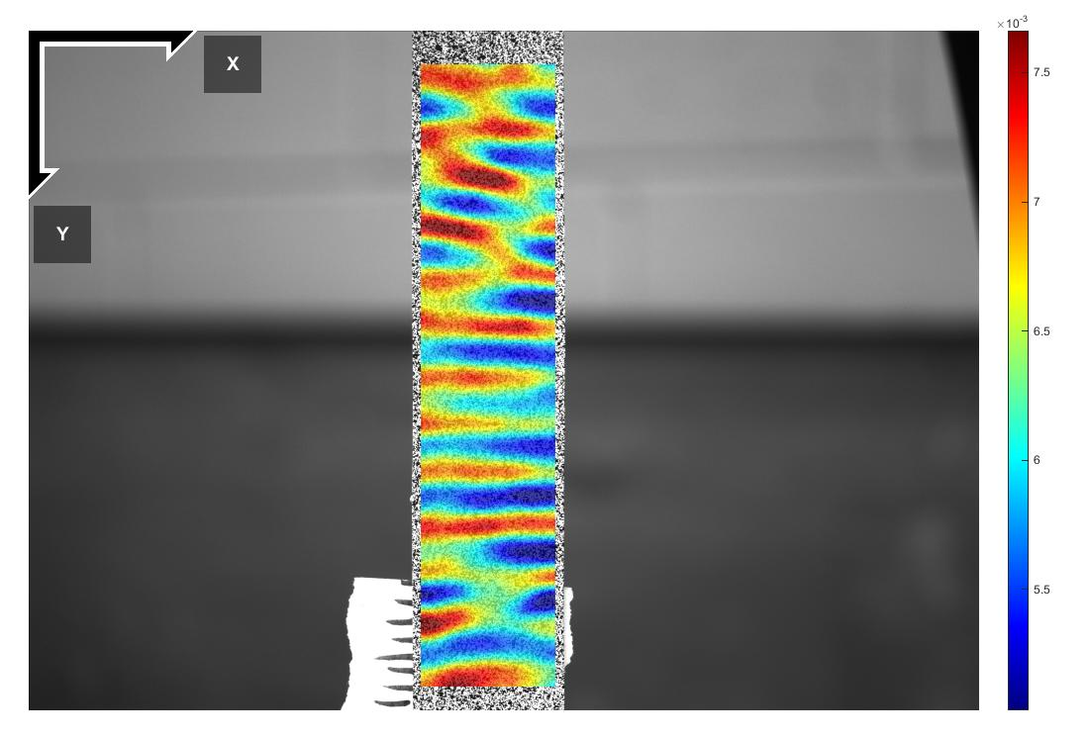
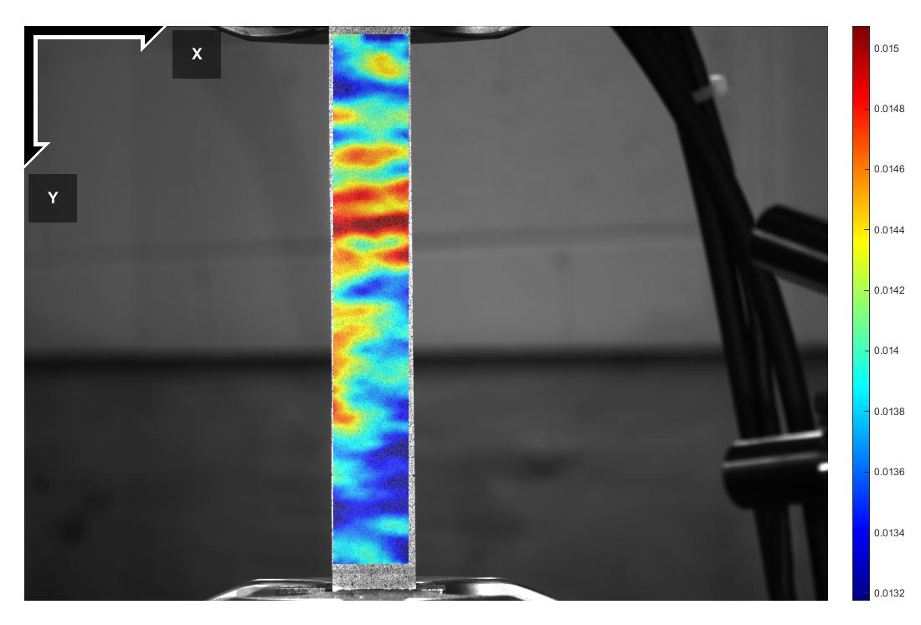
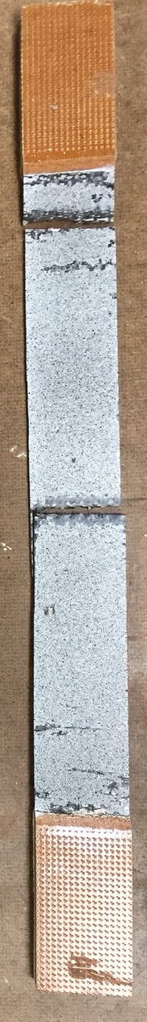
DIC Results (2/2)
Unidirectional and plain weave beam
Unidirectional
Plain weave

Slide 10
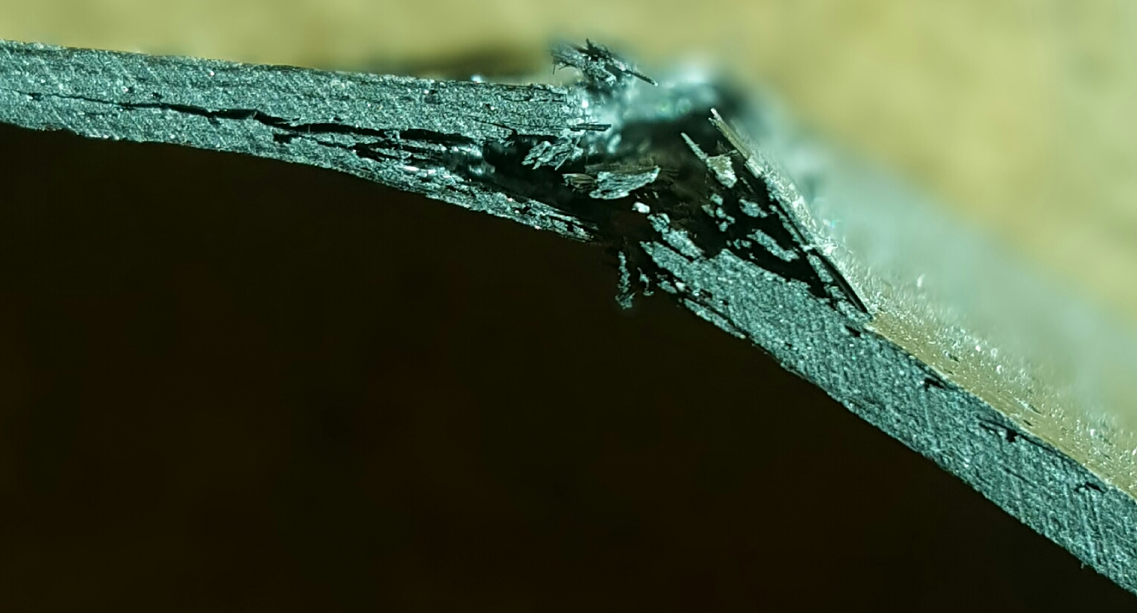
Summary
Capability of DIC technique has been validated
  Can predict failure in pre-damaged samples
  Unpredictable without strain analysis
Establish better understanding of failure mechanisms
Future works:
  Investigate the limitations of DIC method
  Expand knowledge of composites into more fields
Notes:
Can further into application of real-world scenarios/structures

Slide 11
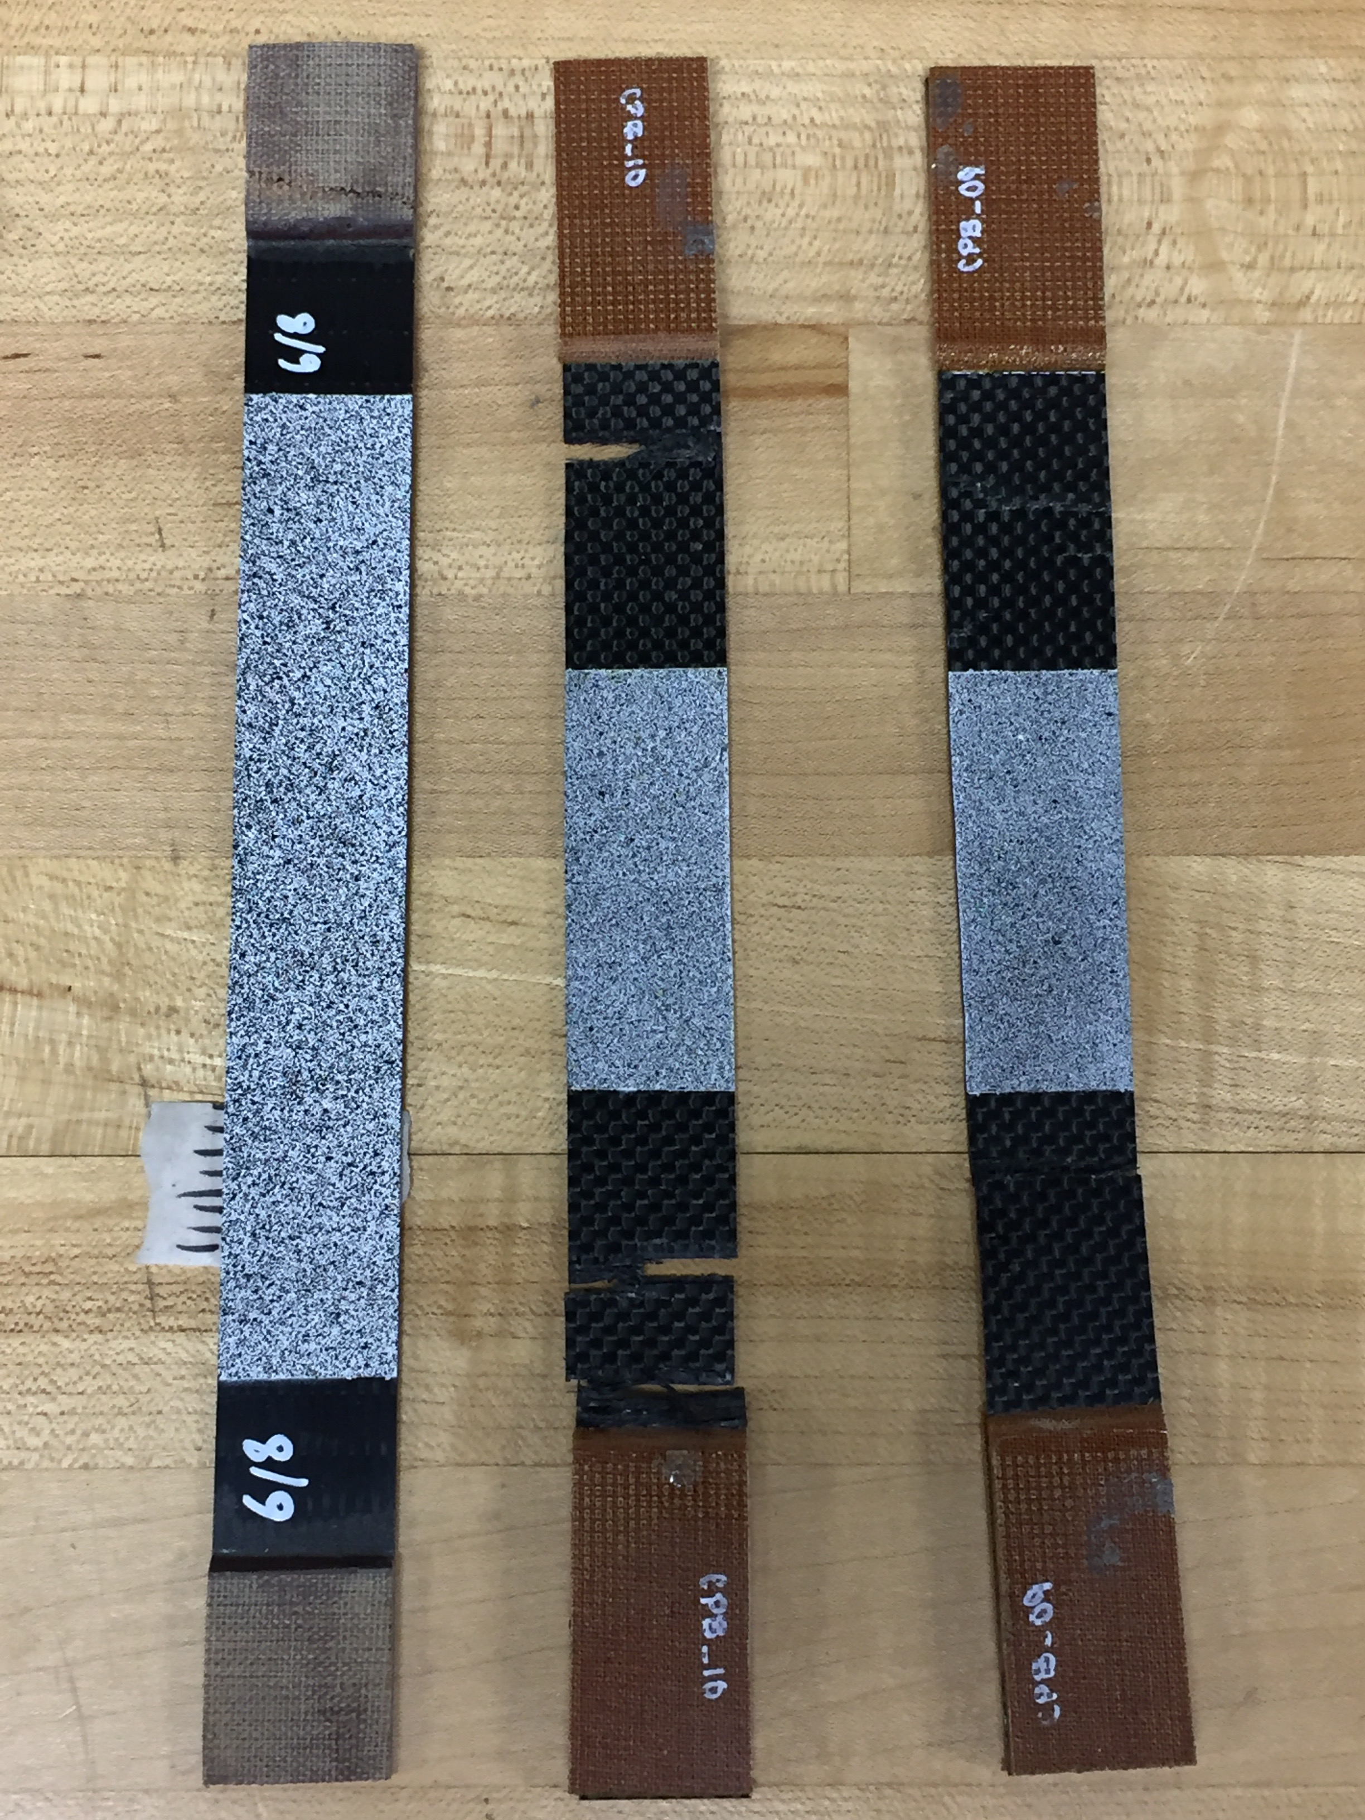
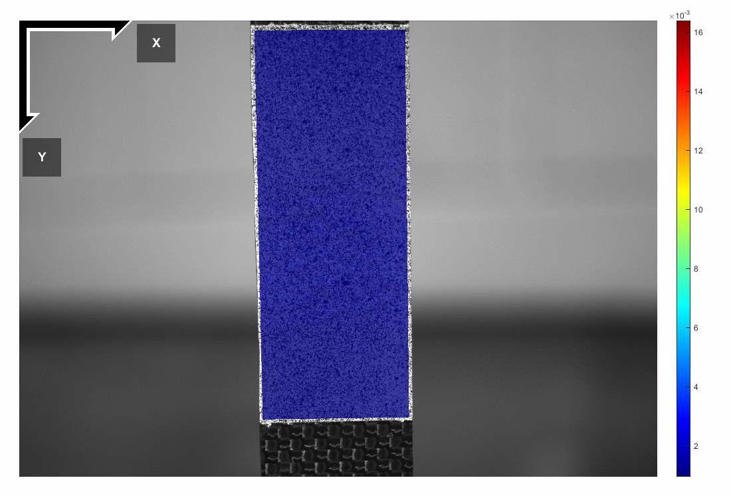
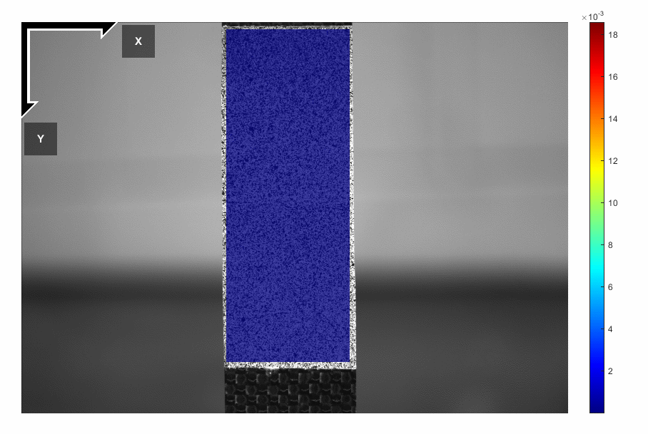
Note on DIC
CPB-09
CPB-10
Alignment Issue
Speckle Sizing
Notes:
CPB_09: beam itself actually got torqued when placed into the testing machine, resulting in some of the beam being further away from the camera. This created an illusion that there was more displacement
CPB_10: The speckle size was too small for the camera distance. This caused the DIC to actually pick up on the carbon pattern beneath the paint because the DIC parameters were consequently focused as well

Slide 12
Materials & Sample Preparation (cont.)
Composite Strip Fabrication
Wet Lay-up
  Cut 8 pieces of carbon fiber with dimensions of 30.5 cm x 25.4 cm
    For unidirectional samples, the 30.5 cm section must be along direction of fibers
  Place sheet of release film on a flat surface
  Apply thin layer of epoxy to release film
  Place 1 layer of carbon fiber on top of layer of epoxy
  Use a paintbrush to push the carbon fiber into the epoxy
  Apply another thin layer of epoxy on top of carbon fiber sheet
  Repeat steps 4 – 6 for all 8 layers of carbon fiber
  Apply a thin layer of epoxy on top of the final layer of carbon fiber
Curing Process
  Place breather cloth around perimeter of the wet composite sheet
  Place seal tape outside of breather cloth
  Cover sample by bonding a sheet of release film to the seal tape
  Apply vacuum ensuring the top layer of release film is pulled against the sheet evenly
  Place the sheet, with vacuum still applied, in industrial oven
  Run the oven using the following heating process:
    80 ºF for 5 Hours
    180 ºF for 8 Hours
    Cool to room temperature
  Remove vacuum and release film
Final fabrication process
  Cut 4 strips of material to be used for grip tabs at 30.5 cm long and 2.54 cm wide
  Use a belt sander to cut away material to leave a 45º angle on one edge of the grip
  Use epoxy to bond grip material to all 4 long edges of previously fabricated composite sheet
  Allow at least 24 hours to fully cure
  Use wet-tile saw to cut the sheet into strips 10” long and 1” wide

Slide 13
Materials & Sample Preparation (cont.)
Electrode Attachment
Paint Speckle Pattern
  Apply 4 coats of base color using spray paint at 15 minute intervals
  Hold can of spray paint roughly 45 cm from surface
  Depress nozzle of spray can and quickly move over the surface of the sample to apply a light mist of paint
  Repeat above step 3 to 4 times to achieve a constant speckle pattern

